Slide 1

Presentation on Rating Prediction Project
Presented by Neha Singh

Slide 2
Agenda:
Overview.
Problem Statement.
Problem Understanding.
What is Rating Prediction?
Importance of Rating Prediction Project.
Data Analysis and Model Building Flow Chart.
Exploratory data analysis.
Visualizations.
Analysis.
Model Building.
Hyper Parameter Tunning.
Conclusion.

Slide 3
OVERVIEW:
In this particular presentation we will be looking on:
How to analyze the dataset of Rating Prediction Project.
What are the EDA steps in cleaning the dataset.
Overall analysis on the problem.
Model building from the cleaned dataset.
Saving the best model.

Slide 4

Problem Statement:
We have a client who has a website where people write different reviews for technical products. Now they are adding a new feature to their website i.e. The reviewer will have to add stars(rating) as well with the review. The rating is out 5 stars and it only has 5 options available 1 star, 2 stars, 3 stars, 4 stars, 5 stars. Now they want to predict ratings for the reviews which were written in the past and they don’t have a rating. So, we have to build an application which can predict the rating by seeing the review.

Slide 5
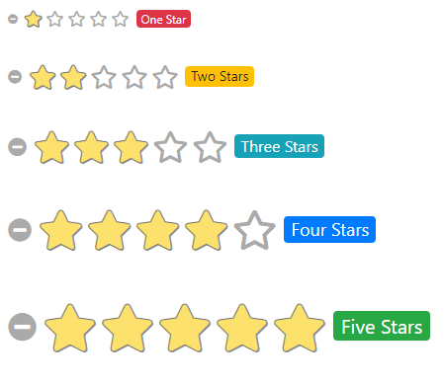
Problem Understanding:
Rating prediction is a well-known recommendation task aiming to predict a user’s rating for those items which were not rated yet by her. Predictions are computed from users’ explicit feedback, i.e. their ratings provided on some items in the past. Another type of feedback are user reviews provided on items which implicitly express users’ opinions on items. Recent studies indicate that opinions inferred from users’ reviews on items are strong predictors of user’s implicit feedback or even ratings and thus, should be utilized in computation.

Slide 6

What is RATING PREDICTION?
Rating prediction is a well-known recommendation task aiming to predict a user's rating for those items which were not rated yet by her. Predictions are computed from users' explicit feedback, i.e. their ratings provided on some items in the past.

Slide 7
Importance of Malignant Comment Classifier.
The rise in E-commerce has brought a significant rise in the importance of customer reviews. There are hundreds of review sites online and massive amounts of reviews for every product. Customers have changed their way of shopping and according to a recent survey, 70 percent of customers say that they use rating filters to filter out low rated items in their searches. The ability to successfully decide whether a review will be helpful to other customers and thus give the product more exposure is vital to companies that support these reviews, companies like Google, Amazon and Yelp!. There are two main methods to approach this problem. The first one is based on review text content analysis and uses the principles of natural language process (the NLP method). This method lacks the insights that can be drawn from the relationship between costumers and items. The second one is based on recommender systems, specifically on collaborative filtering, and focuses on the reviewer’s point of view.

Slide 8
Data Analysis and Model Building Flowchart
Import Libraries
Import Dataset
Visualizations
(EDA)
Data Balancing
TF-IDF Vectorizer
NLTK Text Pre-Processing
Model Building
Hyper Parameter Tuning
Saving the model

Slide 9
Exploratory Data Analysis:
Importing necessary libraries and loading dataset as a data frame.
Checked some statistical information like shape, number of unique values present, info, null values, value counts etc.
Checked for null values and I replaced those null values using imputation method. And removed Unnamed: 0.
Visualized each feature using seaborn and matplotlib libraries by plotting distribution plot and wordcloud for each ratings.
Done text pre-processing techniques like Removing Punctuations and other special characters, Splitting the comments into individual words, Removing Stop Words, Stemming and Lemmatization.
After getting a cleaned data used TF-IDF vectorizer. It’ll help to transform the text data to feature vector which can be used as input in our 6 modelling. It is a common algorithm to transform text into numbers. It measures the originality of a word by comparing the frequency of appearance of a word in a document with the number of documents the words appear in. Mathematically, TF-IDF = TF(t*d)*IDF(t,d)

Slide 10
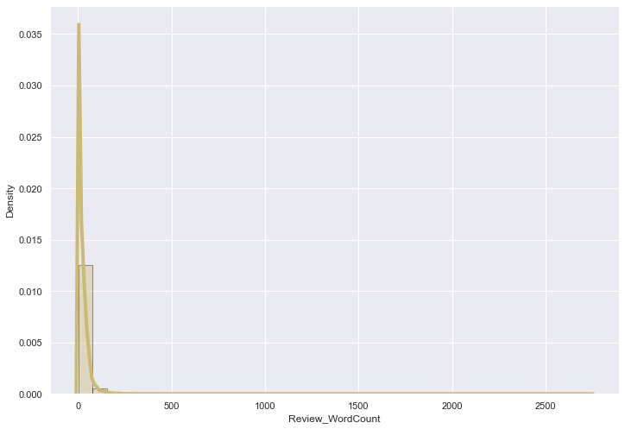
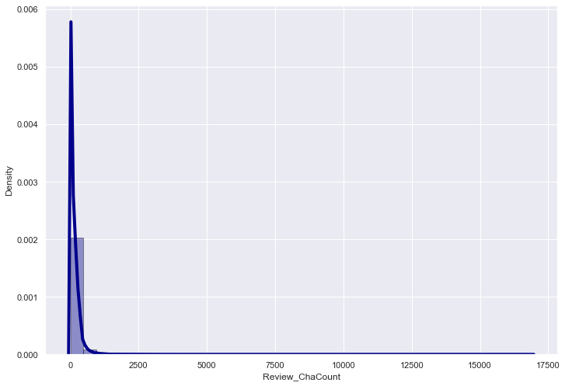
Visualization:
By observing the histogram we can clearly see that most of our text is having the number of words in the range of 0 to 200, But some of the reviews are too lengthy which may act like outliers in our data.
Above plot represents histogram for character count of Review text, which is quite similar to the histogram of word count.

Slide 11
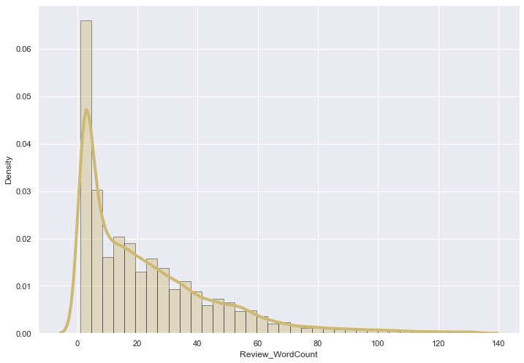
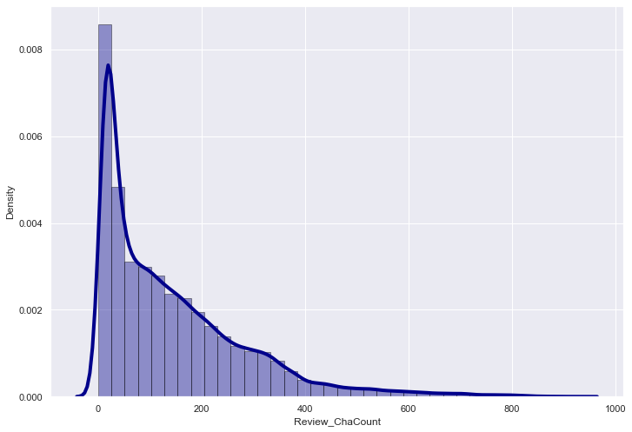
Visualization:
As we know that some of the review are too lengthy, so i have to treat them as outliers and remove them using z_score method. After removing the outliers the word count and character count looks as below.
After plotting histograms for word counts and character counts and after removing outliers we can see we are left out with good range of number of words and characters.

Slide 12
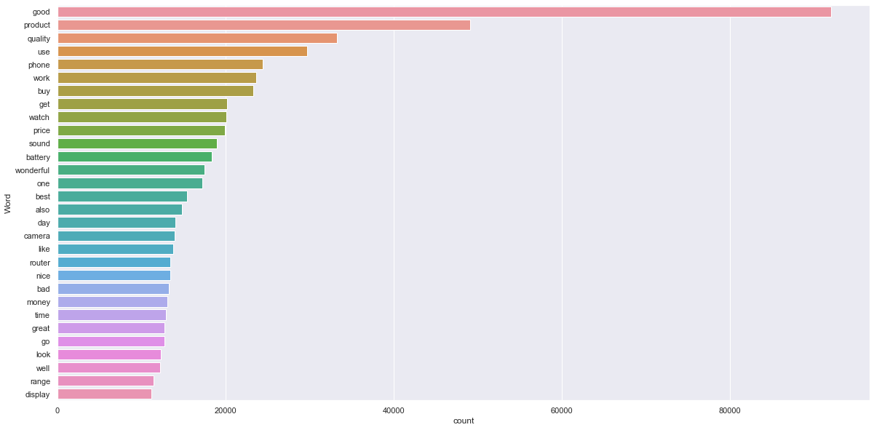
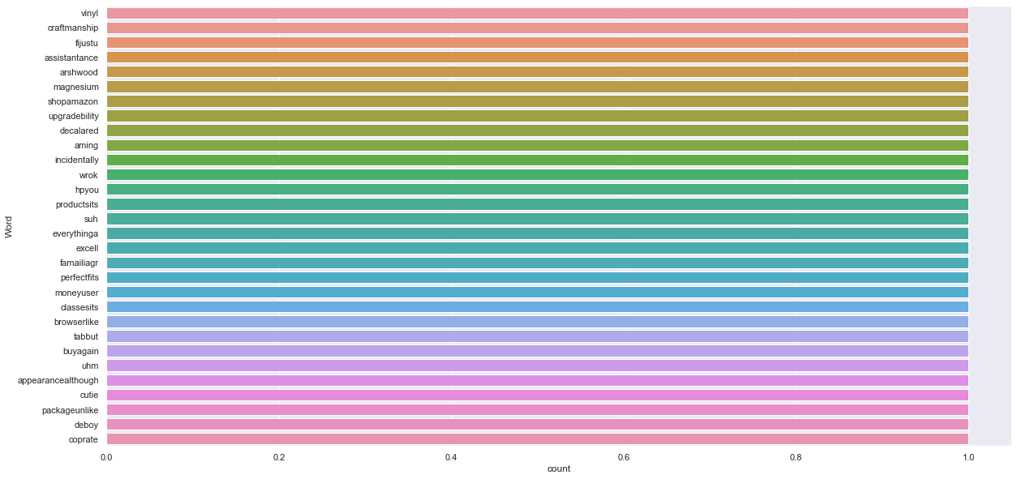
Visualization:
By seeing the above plot we can see that Good, product, quality......are occurring frequently. And the second plot shows rarely occuring words.

Slide 13
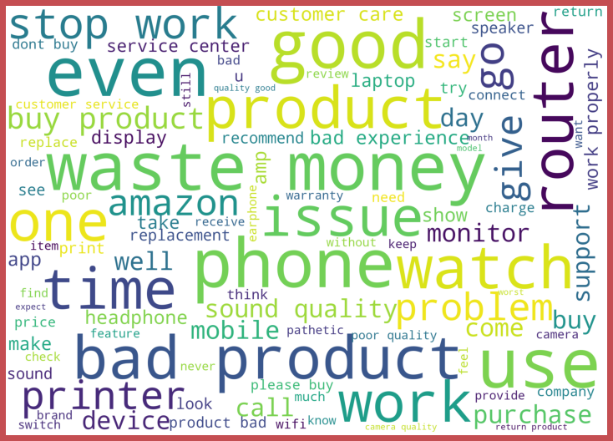
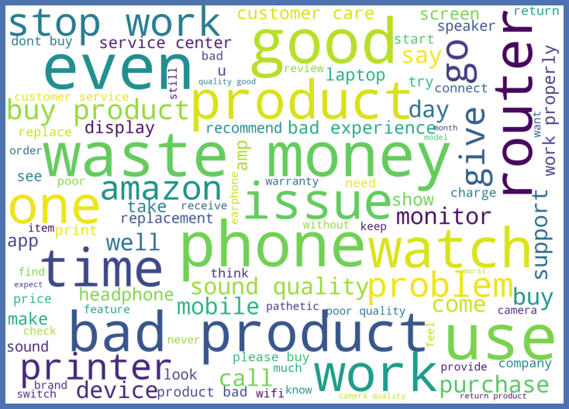
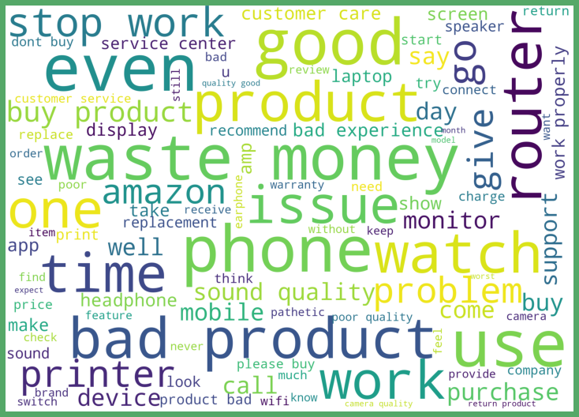
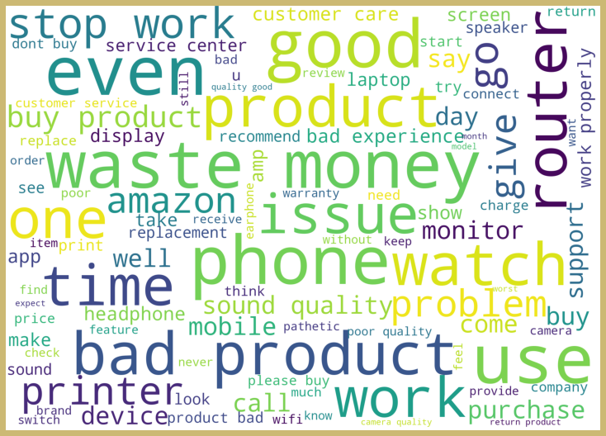

Visualization:
Rating 1:
Rating 2:
Rating 3:
Rating 4:
Rating 5:
From the above plots we can clearly see the words which are indication of Reviewer's opinion on products.
Here most frequent words used for each Rating is displayed in the word cloud.

Slide 14
Analysis:
This project is more about exploration, feature engineering and classification that can be done on this data. Since the data set is huge and includes multiclassification of ratings, we can do good amount of data exploration and derive some interesting features using the review text column available.
Just make the reviews more appropriate so that we’ll get less word to process and get more accuracy.
Removed extra spaces, converted email address into email keyword, likely wise phone number etc. Tried to make Reviews small and more appropriate as much as it was possible.
After getting a cleaned data used TF-IDF vectorizer. It’ll help to transform the text data to feature vector which can be used as input in our modelling. It is a common algorithm to transform text into numbers. It measures the originality of a word by comparing the frequency of appearance of a word in a document with the number of documents the words appear in.
Balanced the data using SMOTE mechanism.

Slide 15
Model Building:
In this nlp based project we need to predict ratings which are multiclassifiers. I have converted the text into vectors using TFIDF vectorizer and separated our feature and labels then build the model using One Vs Rest Classifier. Among all the algorithms which I have used for this purpose I have chosen SGDClassifier as best suitable algorithm for our final model as it is performing well compared to other algorithms while evaluating with different metrics I have used following algorithms and evaluated them
LinearSVC
LogisticRegression
DecisionTreeClassifier
RandomForestClassifier
XGBClassifier
SGDClassifier
From all of these above models SGDClassifier was giving me good performance.

Slide 16
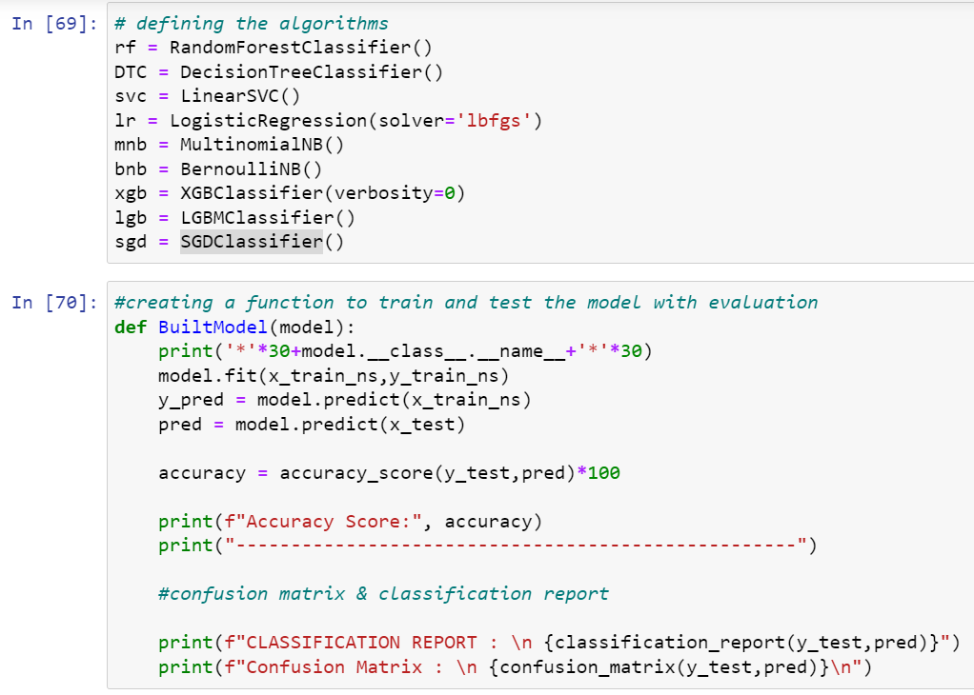
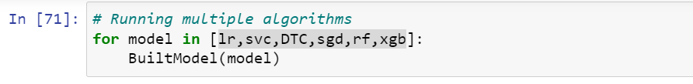
I have used 6 classification algorithms. First, I have created 6 different classification algorithms and are appended in the variable models. Followed by TFIDF vectorization and data balancing. Then, ran a for loop which contained the accuracy of the models along with different evaluation metrics.

Slide 17
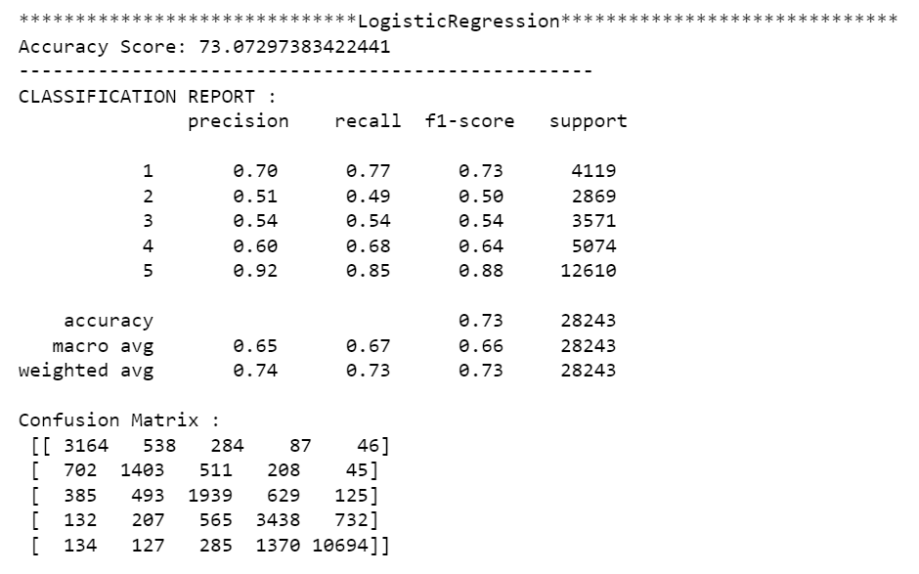
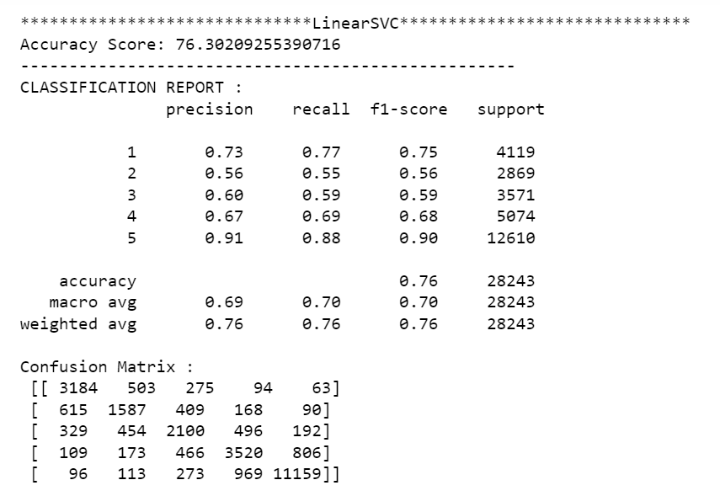
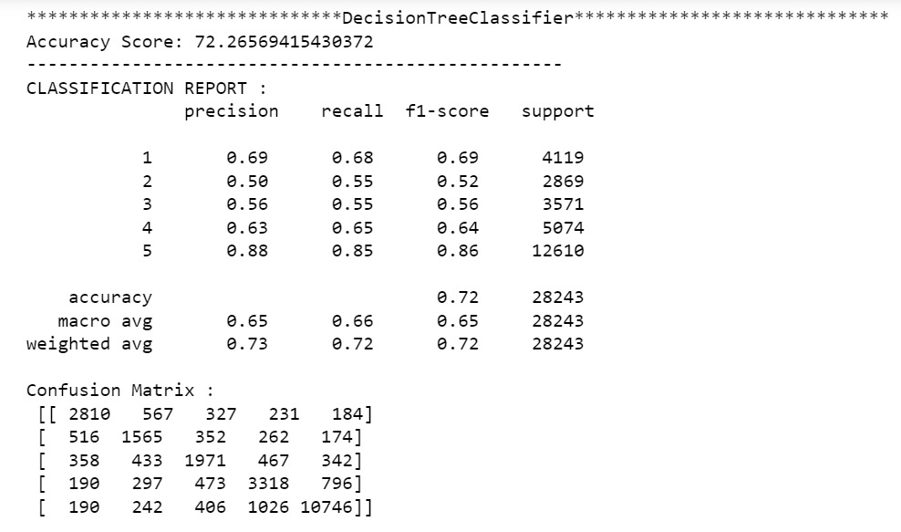

Slide 18
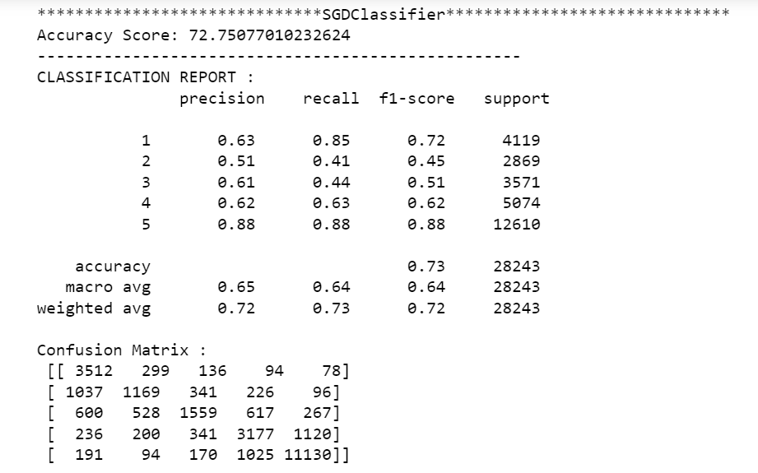
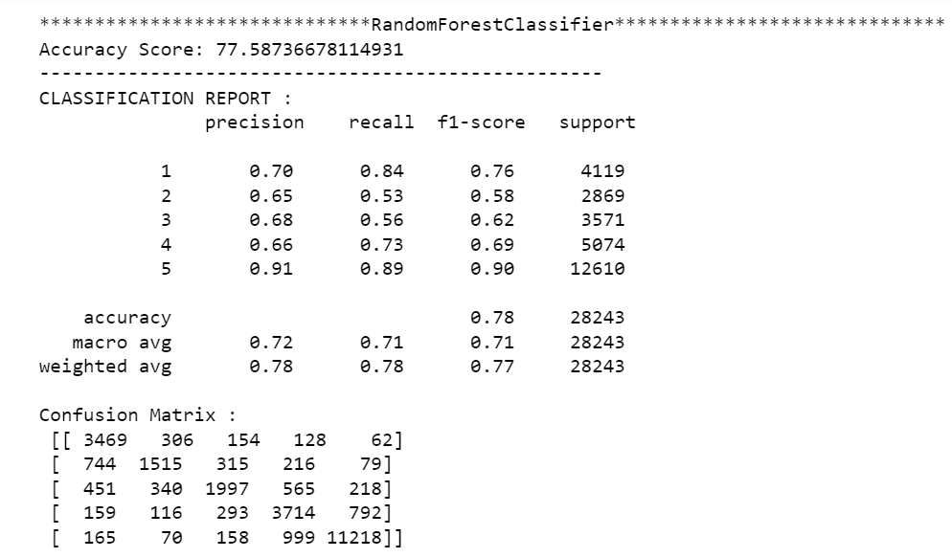
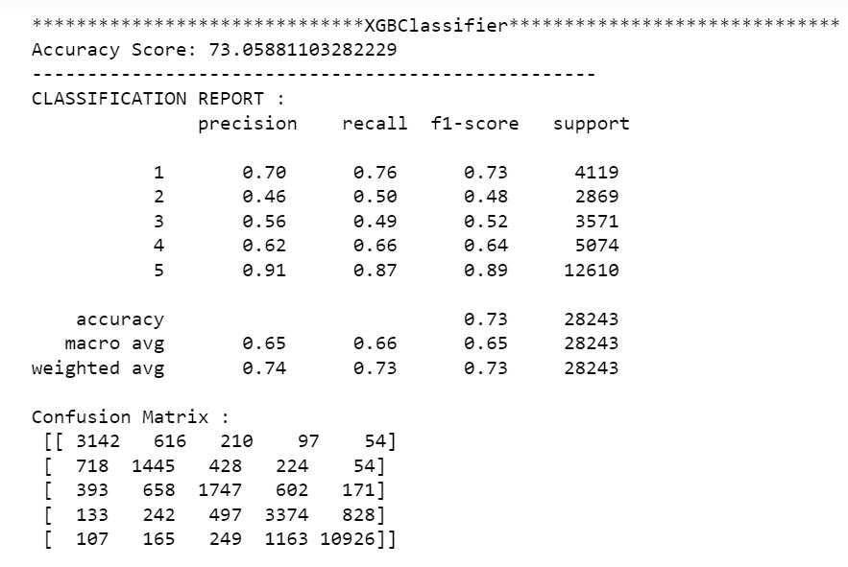

Slide 19
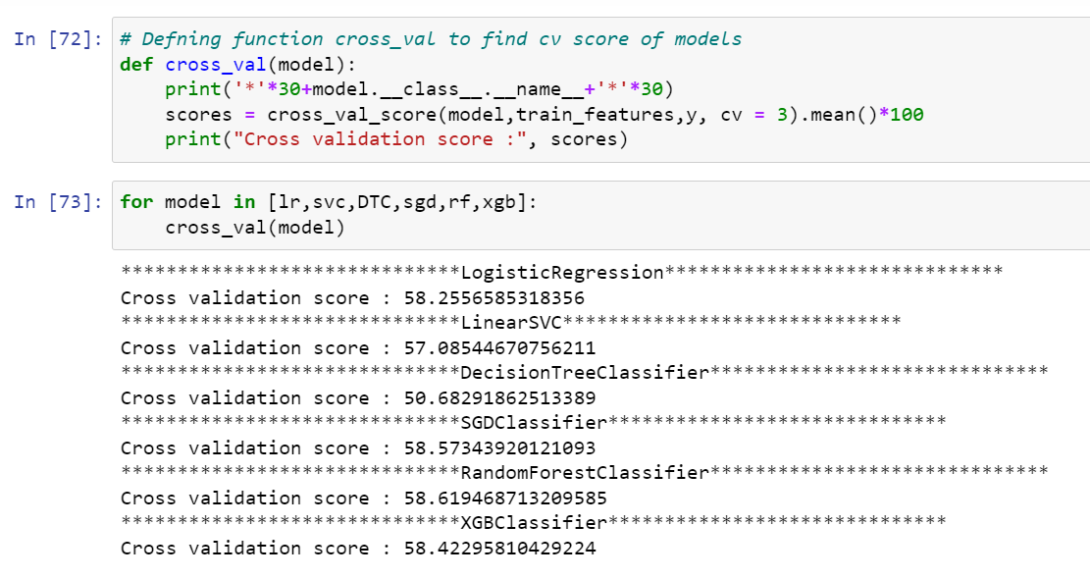
Great all our algorithms are giving good cv scores. Among these algorithms I am selecting SGD Classifier as best fitting algorithm for our final model as it is giving least difference between accuracy and cv score.

Slide 20
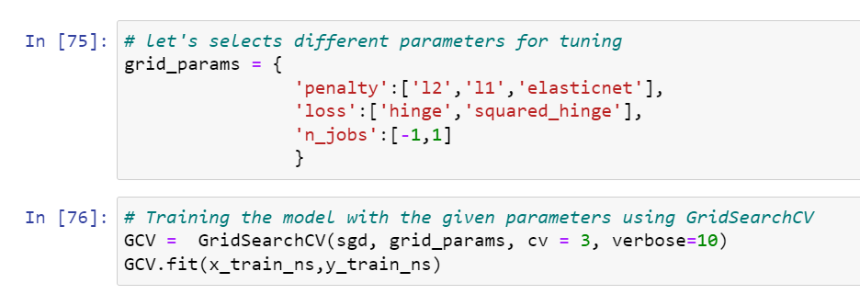
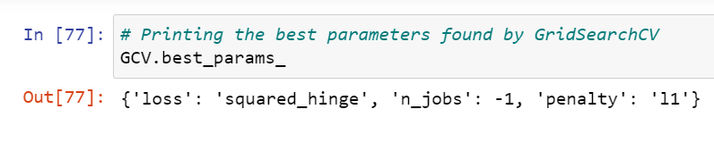
Hyper Parameter Tunning:
And after doing hyperparameter tuning I got above parameters as best suitable parameters for our final model.
I have trained my final model using these parameters and it was unable to increase the accuracy of the model.

Slide 21
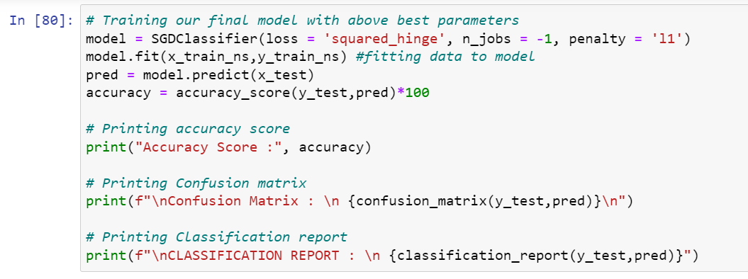
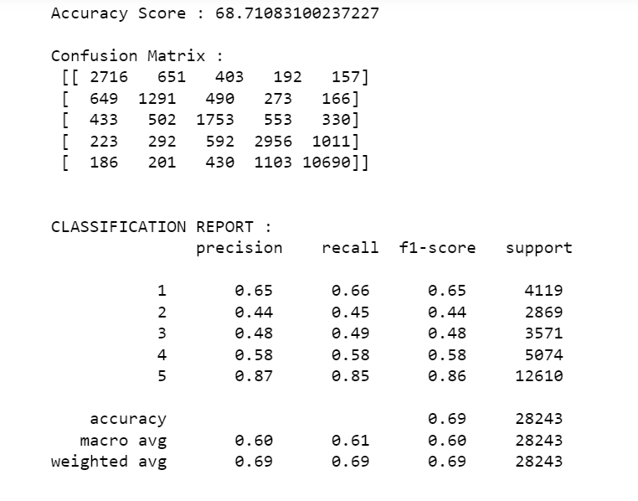
After training and building our final model I saved this model into .pkl file.

Slide 22

Conclusion:
In this project report, we have used NLP machine learning algorithms to predict the Ratings. We have mentioned the step by step procedure to analyze the dataset and finding the correlation between the features.
Thus we can select the features which are correlated to each other and are independent in nature. The power of visualization has helped us in understanding the data by graphical representation it has made me to understand what data is trying to say.
Data cleaning is one of the most important steps to remove unrealistic values and unnecessary punctuatuions, urls, email address, stop words.
These feature set were then given as an input to 6 algorithms and a hyper parameter tunning was done to the best model. Hence we calculated the performance of each model using different performance metrics and compared them based on these metrics.
Then we have also saved the best model.

Slide 23

Thank You

